Slide 1
CREATION OF CALCULATOR
This project presents the design and development of a basic calculator application capable of performing standard arithmetic operations such as addition, subtraction, multiplication, and division.
The calculator is designed with a user-friendly, intuitive interface that ensures ease of use and is optimized for a wide range of devices through a responsive layout.
Using technologies like HTML, CSS, and JavaScript, the application features a structured and functional layout that adapts to different screen sizes, providing an optimal user experience on desktops, tablets, and mobile devices
.

Slide 2
PROJECT OVERVIEW
A web-based calculator with a clean, intuitive design.
Primary functions:
Basic arithmetic (addition, subtraction, multiplication, division)
User input and real-time calculations
Responsive layout for desktop, tablet, and mobile devices
Technologies used: HTML, CSS, JavaScript.

Slide 3
KEY FEATURES
1. Arithmetic Operations
Addition, subtraction, multiplication, and division.
Clear button to reset calculations.
Equals button to display results.
2. Responsive Design
Adapts seamlessly to different screen sizes.
Optimized for usability across desktops, tablets, and smartphones.

Slide 4
TECHNOLOGY STACK
HTML: Structure of the calculator (buttons, display screen). CSS: Styling and layout, with focus on responsive design. JavaScript: Core functionality:
Handles button clicks and calculation logic.
Displays results in real-time.

Slide 5
DESIGN & LAYOUT
HTML Structure: Grid layout for buttons.
CSS Styling: Visual styling and responsive adjustments.
Use of CSS Flexbox/Grid for a scalable layout.
Media queries to adjust button size, display screen, and spacing based on screen width.

Slide 6
IMPLEMENTATION - HTML
Buttons for numbers (0-9) and operators (+, -, *, /).
Separate buttons for clear (C) and equal-to (=).
Display screen for showing input and results.

Slide 7
IMPLEMENTATION - CSS
Desktop Layout: Full-sized grid with a large display and buttons.
Tablet Layout: Scaled-down buttons and grid layout adjustments.
Mobile Layout: Compact grid, larger buttons for easy tapping.

Slide 8
IMPLEMENTATION - JAVASCRIPT
Event listeners for each button.
Functions for each arithmetic operation.
Display update based on button clicks.
Error handling for invalid inputs (e.g., dividing by zero).

Slide 9
USER INTERFACE
Display: Real-time updates to show current inputs and results.
Buttons: Clear, equal-to, number keys, and operation keys.
Responsive Layout: Changes dynamically based on device screen size.

Slide 10
DEMO
A quick demonstration of the calculator’s interface and responsiveness.
Show how inputs update the display.
Perform sample calculations.
Demonstrate layout adjustments on different screen sizes.

Slide 11
RESPONSIVE CALCULATOR
Accessibility on various devices without compromising functionality.
Optimized user experience with a clean and consistent interface.
A foundation for learning responsive design and user interface principles.

Slide 12
CHALLENGES FEED
Handling complex inputs (e.g., multiple operations in sequence).
Ensuring consistent responsiveness across all screen sizes.
Managing JavaScript event handling efficiently.

Slide 13
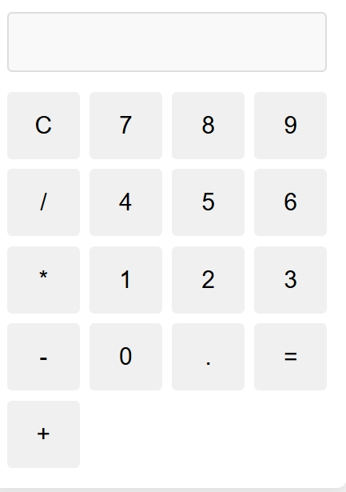
Output

Slide 14
CONCLUSION
Project Summary: A basic, functional calculator with a responsive design.
Learning Outcomes:
Developed a foundational web application using HTML, CSS, JavaScript.
Gained experience with responsive web design principles.
Future Enhancements:
Add more complex operations (e.g., square root, exponentiation).
Improve UX with animations and additional accessibility features.

Slide 15
THANK YOU

